Slide 1
Binomial Coefficients
CS/APMA 202
Rosen section 4.4
Aaron Bloomfield

Slide 2
Binomial Coefficients
It allows us to do a quick expansion of (x+y)^{n}
Why it’s really important:
It provides a good context to present proofs
  Especially combinatorial proofs

Slide 3
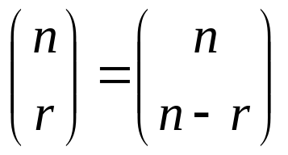
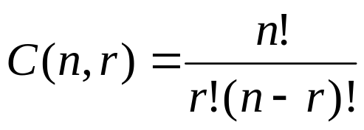
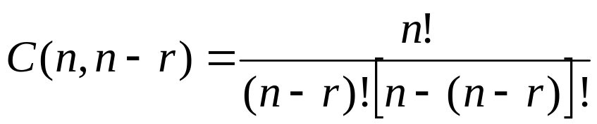
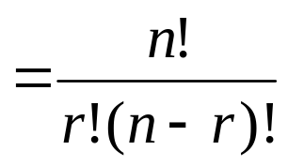
Review: corollary 1 from section 4.3
Let n and r be non-negative integers with
r ≤ n. Then C(n,r) = C(n,n-r)
Or,
Proof (from last slide set):

Slide 4
Review: combinatorial proof
A combinatorial proof is a proof that uses counting arguments to prove a theorem, rather than some other method such as algebraic techniques
Essentially, show that both sides of the proof manage to count the same objects
  Usually in the form of an English explanation with supporting formulae

Slide 5

Polynomial expansion
Consider (x+y)³:
Rephrase it as:
When choosing x twice and y once, there are C(3,2) = C(3,1) = 3 ways to choose where the x comes from
When choosing x once and y twice, there are C(3,2) = C(3,1) = 3 ways to choose where the y comes from

Slide 6
Polynomial expansion
Consider
To obtain the x⁵ term
  Each time you multiple by (x+y), you select the x
  Thus, of the 5 choices, you choose x 5 times
    C(5,5) = 1
  Alternatively, you choose y 0 times
    C(5,0) = 1
To obtain the x⁴y term
  Four of the times you multiply by (x+y), you select the x
    The other time you select the y
  Thus, of the 5 choices, you choose x 4 times
    C(5,4) = 5
  Alternatively, you choose y 1 time
    C(5,1) = 5
To obtain the x³y² term
  C(5,3) = C(5,2) = 10
Etc…

Slide 7
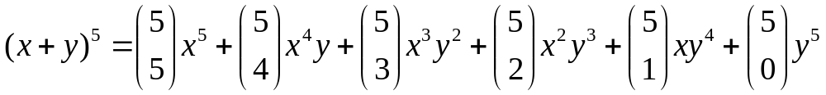
Polynomial expansion
For (x+y)⁵

Slide 8
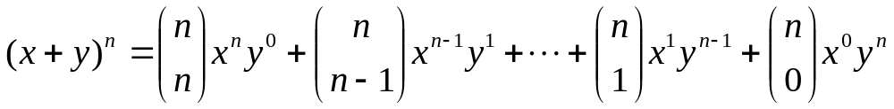
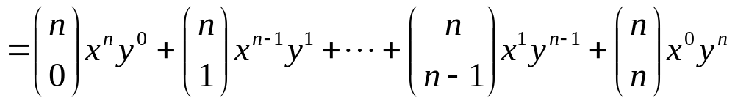
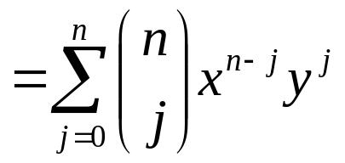
Polynomial expansion:
The binomial theorem
For (x+y)^{n}
The book calls this Theorem 1

Slide 9
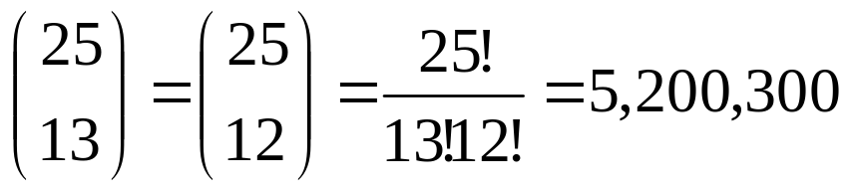
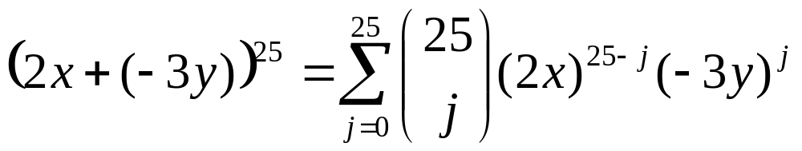
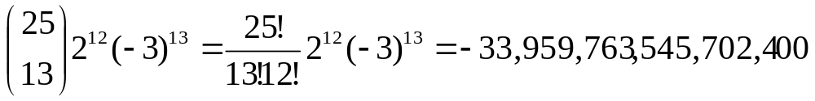
Examples
What is the coefficient of x¹²y¹³ in (x+y)²⁵?
What is the coefficient of x¹²y¹³ in (2x-3y)²⁵?
  Rephrase it as (2x+(-3y))²⁵
  The coefficient occurs when j=13:

Slide 10
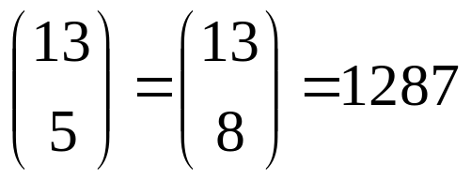
Rosen, section 4.4, question 4
Find the coefficient of x⁵y⁸ in (x+y)¹³
Answer:

Slide 11
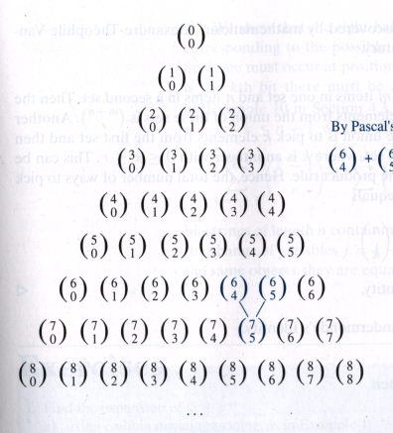
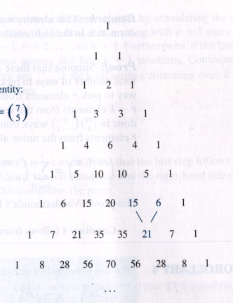
Pascal’s triangle
0
1
2
3
4
5
6
7
8
n =

Slide 12
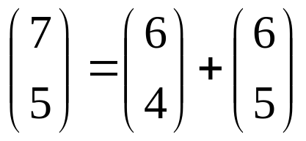
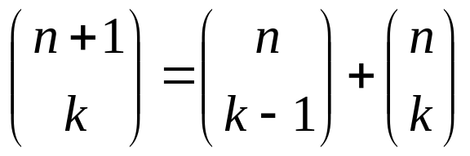
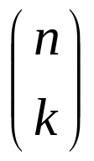
Pascal’s Identity
By Pascal’s identity: or 21=15+6
Let n and k be positive integers with n ≥ k.
Then
  or C(n+1,k) = C(n,k-1) + C(n,k)
The book calls this Theorem 2
We will prove this via two ways:
  Combinatorial proof
  Using the formula for

Slide 13
Combinatorial proof of Pascal’s identity
Prove C(n+1,k) = C(n,k-1) + C(n,k)
Consider a set T of n+1 elements
  We want to choose a subset of k elements
  We will count the number of subsets of k elements via 2 methods
Method 1: There are C(n+1,k) ways to choose such a subset
Method 2: Let a be an element of set T
Two cases
  a is in such a subset
    There are C(n,k-1) ways to choose such a subset
  a is not in such a subset
    There are C(n,k) ways to choose such a subset
Thus, there are C(n,k-1) + C(n,k) ways to choose a subset of k elements
Therefore, C(n+1,k) = C(n,k-1) + C(n,k)

Slide 14

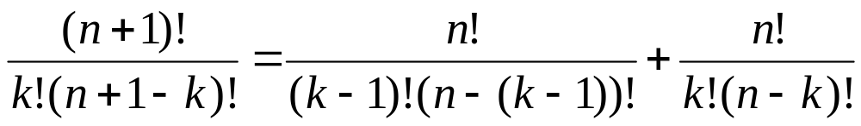
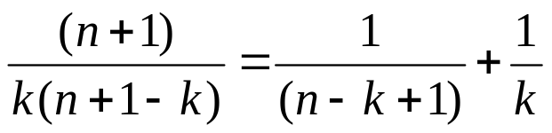
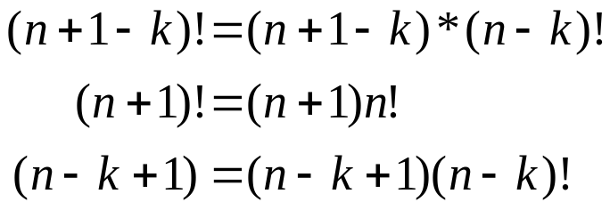
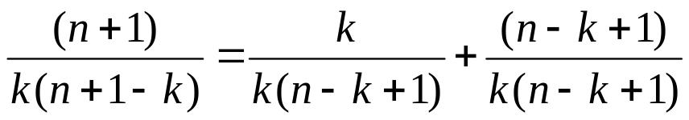


Rosen, section 4.4, question 19: algebraic proof of Pascal’s identity
Substitutions:

Slide 15

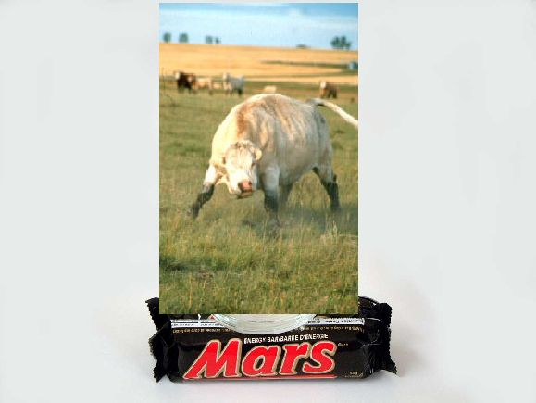

April Fools Day Jokes
Privacy policy
From time to time, in order to improve Google Gulp's usefulness for our users, Google Gulp will send packets of data related to your usage of this product from a wireless transmitter embedded in the base of your Google Gulp bottle to the GulpPlex™, a heavily guarded, massively parallel server farm whose location is known only to Eric Schmidt, who carries its GPS coordinates on a 64-bit-encrypted smart card locked in a stainless-steel briefcase handcuffed to his right wrist. No personally identifiable information of any kind related to your consumption of Google Gulp or any other current or future Google Foods product will ever be given, sold, bartered, auctioned off, tossed into a late-night poker pot, or otherwise transferred in any way to any untrustworthy third party, ever, we swear. See our Privacy Policy.
http://www.google.com/googlegulp/
(or do a Google search for ‘gulp’)

Slide 16
Pascal’s triangle
0
1
2
3
4
5
6
7
8
1
2
4
8
16
32
64
128
256
n =
sum =
= 2^{n}

Slide 17
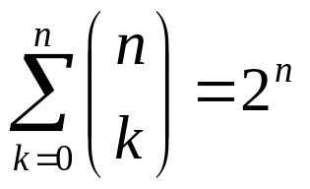
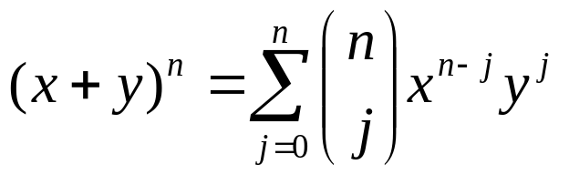

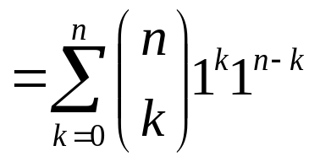
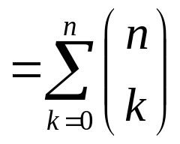
Proof practice: corollary 1
Let n be a non-negative integer. Then
Algebraic proof

Slide 18



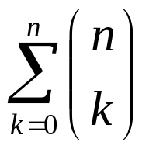
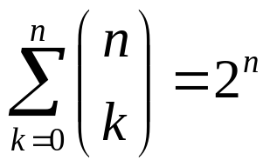
Proof practice: corollary 1
Let n be a non-negative integer. Then
Combinatorial proof
  A set with n elements has 2^{n} subsets
    By definition of power set
  Each subset has either 0 or 1 or 2 or … or n elements
    There are subsets with 0 elements, subsets with 1 element, … and subsets with n elements
    Thus, the total number of subsets is
  Thus,

Slide 19
End of lecture on 5 April 2005

Slide 20
Pascal’s triangle
0
1
2
3
4
5
6
7
8
n =

Slide 21
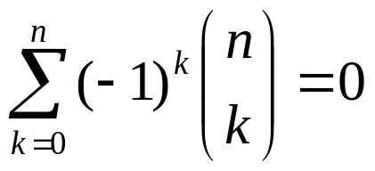

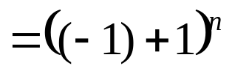
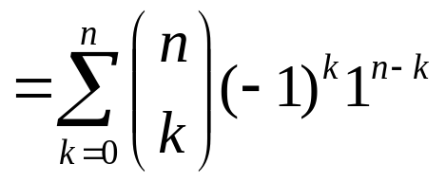
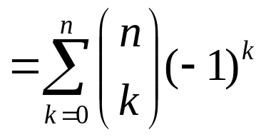
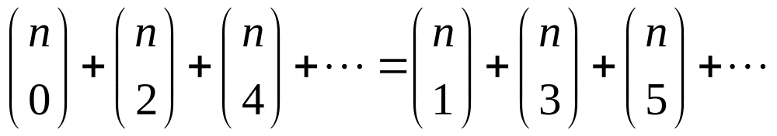
Proof practice: corollary 2
Let n be a positive integer. Then
Algebraic proof
This implies that

Slide 22
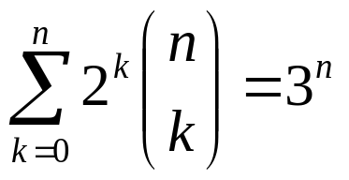

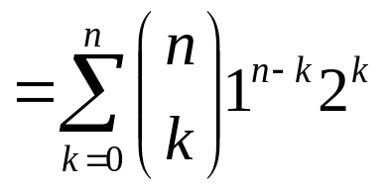
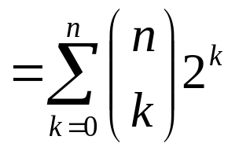
Proof practice: corollary 3
Let n be a non-negative integer. Then
Algebraic proof

Slide 23
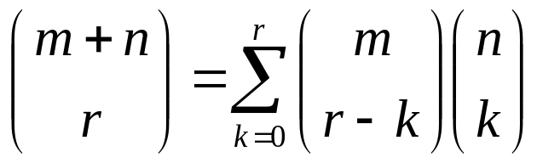
Vandermonde’s identity
Let m, n, and r be non-negative integers with r not exceeding either m or n. Then
The book calls this Theorem 3

Slide 24


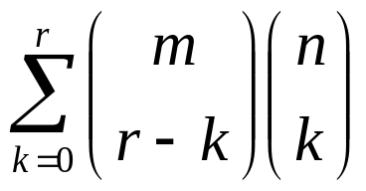
Combinatorial proof of Vandermonde’s identity
Consider two sets, one with m items and one with n items
  Then there are ways to choose r items from the union of those two sets
Next, we’ll find that value via a different means
  Pick k elements from the set with n elements
  Pick the remaining r-k elements from the set with m elements
  Via the product rule, there are ways to do that for EACH value of k
  Lastly, consider this for all values of k:
Thus,

Slide 25
Review of Rosen, section
4.3, question 11 (a)
How many bit strings of length 10 contain exactly four 1’s?
  Find the positions of the four 1’s
  The order of those positions does not matter
    Positions 2, 3, 5, 7 is the same as positions 7, 5, 3, 2
  Thus, the answer is C(10,4) = 210
Generalization of this result:
  There are C(n,r) possibilities of bit strings of length n containing r ones

Slide 26
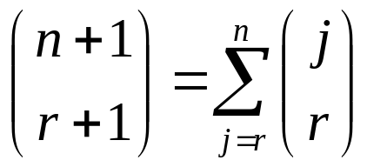
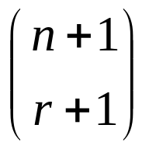
Yet another combinatorial proof
Let n and r be non-negative integers with r ≤ n. Then
  The book calls this Theorem 4
We will do the combinatorial proof by showing that both sides show the ways to count bit strings of length n+1 with r+1 ones
From previous slide: achieves this

Slide 27

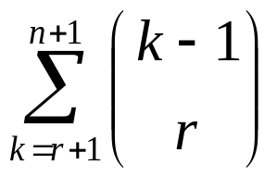
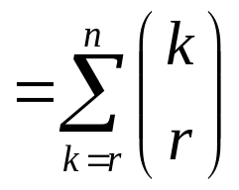
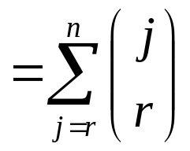
Yet another combinatorial proof
Next, show the right side counts the same objects
The final one must occur at position r+1 or r+2 or … or n+1
Assume that it occurs at the k^{th} bit, where r+1 ≤ k ≤ n+1
  Thus, there must be r ones in the first k-1 positions
  Thus, there are such strings of length k-1
As k can be any value from r+1 to n+1, the total number of possibilities is
Thus,

Slide 28


Rosen, section 4.4, question 24
Show that if p is a prime and k is an integer such that
1 ≤ k ≤ p-1, then p divides
We know that
p divides the numerator (p!) once only
  Because p is prime, it does not have any factors less than p
We need to show that it does NOT divide the denominator
  Otherwise the p factor would cancel out
Since k < p (it was given that k ≤ p-1), p cannot divide k!
Since k ≥ 1, we know that p-k < p, and thus p cannot divide (p-k)!
Thus, p divides the numerator but not the denominator
Thus, p divides

Slide 29
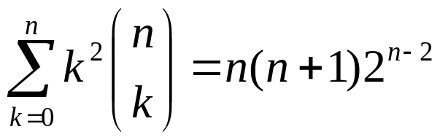
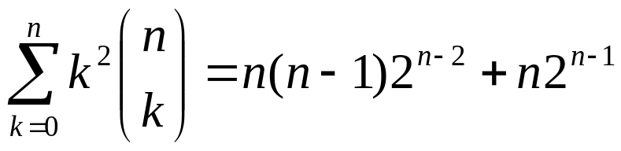
Rosen, section 4.4, question 38
Give a combinatorial proof that if n is positive integer then
Provided hint: show that both sides count the ways to select a subset of a set of n elements together with two not necessarily distinct elements from the subset
Following the other provided hint, we express the right side as follows:

Slide 30
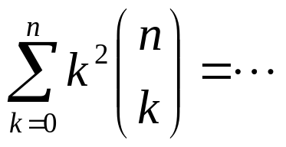
Rosen, section 4.4, question 38
Show the left side properly counts the desired property
Consider each of the possible subset sizes k
Choosing a subset of k elements from a set of n elements
Choosing one of the k elements in the subset twice

Slide 31
Rosen, section 4.4, question 38
Two cases to show the right side: n(n-1)2^{n-2}+n2^{n-1}
  Pick the same element from the subset
    Pick that one element from the set of n elements: total of n possibilities
    Pick the rest of the subset
      As there are n-1 elements left, there are a total of 2^{n-1} possibilities to pick a given subset
    We have to do both
      Thus, by the product rule, the total possibilities is the product of the two
      Thus, the total possibilities is n*2^{n-1}
  Pick different elements from the subset
    Pick the first element from the set of n elements: total of n possibilities
    Pick the next element from the set of n-1 elements: total of n-1 possibilities
    Pick the rest of the subset
      As there are n-2 elements left, there are a total of 2^{n-2} possibilities to pick a given subset
    We have to do all three
      Thus, by the product rule, the total possibilities is the product of the three
      Thus, the total possibilities is n*(n-1)*2^{n-2}
  We do one or the other
    Thus, via the sum rule, the total possibilities is the sum of the two
    Or n*2^{n-1}+n*(n-1)*2^{n-2}

Slide 32
Quick survey
I felt I understood the material in this slide set…
Very well
With some review, I’ll be good
Not really
Not at all

Slide 33
Quick survey
The pace of the lecture for this slide set was…
Fast
About right
A little slow
Too slow

Slide 34
Quick survey
How interesting was the material in this slide set? Be honest!
Wow! That was SOOOOOO cool!
Somewhat interesting
Rather borting
Zzzzzzzzzzz

Slide 35
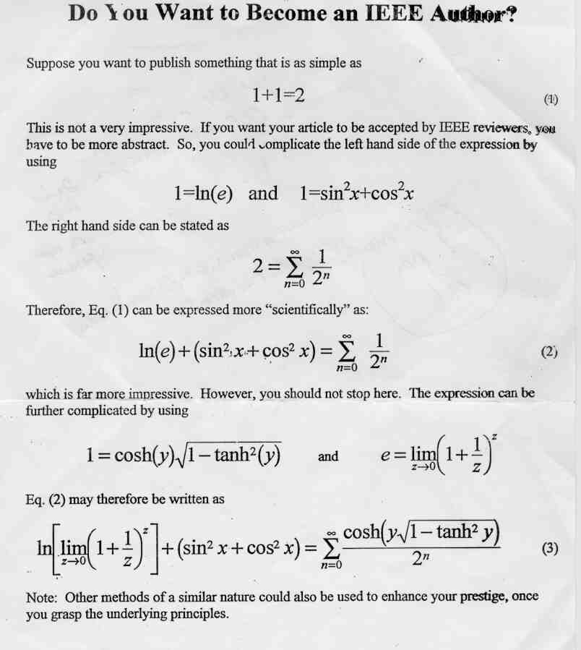
Becoming an IEEE author

